Slide 1





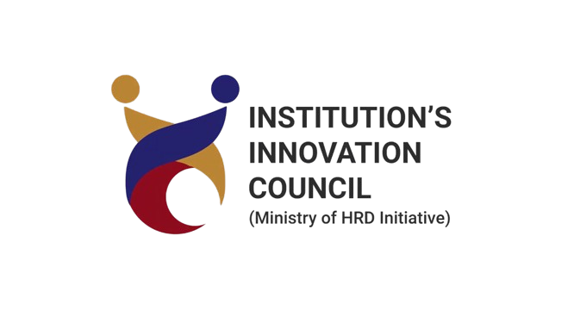
Round 1 Idea Submission
Soul Bytes
Dhanajay Pratap Singh; Ravi Ranjan; Ashutosh Prajapati; Dhawal Verma
Environmental Impact
Integrated Medication Adherence and Management Platform

Slide 2
Soul Bytes
PillSync
PillSync is a web based platform, leveraging the power of AI to provide medication adherence and management.
It prevents Non-Adherence to medicine by prompting the user a reminder, It uses EHR to keep track of previous diagnosis and medications and then implements AI to suggest potential side effects that could be triggered with the new medication.
Prompts users to schedule a doctor visit if any unusual side effects or health issues are detected.
We have AI-Driven Drug Interaction Detection and Side Effect Risk Assessment

Slide 3
Soul Bytes
TECHNICAL APPROACH
Programing Languages:- Python, JavaScript, HTML, Tailwind CSS
Frameworks: React JS, Flask
Web application Framework, future aspect- Mobile application Framework

Slide 4
Soul Bytes
METHODOLOGY
Diagnosis & Prescription
AI model checks for drug-drug interaction
Risk Assessment & sending notification to Doctor
Visit Doctor
No
Popup Reminder to start medication
Yes
Yes
Schedule a reminder for next follow up
No
Any Problem
Recurring Popup reminder for medicine intake according to the course
Yes
If follow up
No
End after course completion

Slide 5
Soul Bytes
FEASIBILITY AND VIABILITY
Machine learning models for drug interaction detection and side effect prediction are well within the reach of modern AI. Pre-existing datasets are available which provide reliable input for AI training. Many APIs provide access to electronic health records (EHR) enabling PillSync to pull real-time data about medications and diagnosis.
As high accuracy AI models require vast amount of data therefore if the data is not available in such quantity or if the quality of data is not up to the mark then it could affect the accuracy of the model.
We are dependent on third party data currently, also we have not optimized the platform large user base due to cost issues.
In future we could use cloud infrastructure that allows scaling based on demand. Partnering with trusted sources like FDA, WHO and reputed hospitals could improve our data quality to a great extent.

Slide 6
Soul Bytes
IMPACT AND BENEFITS
Potentially Impacts on every citizen from a newborn to an elderly person
It helps Doctor to know about medical status of patients easily and give them valuable information about the patients allergies.
It helps patients to take care of them by regular notifications and reminders for their dosage and health checkup.
It creates transparency between doctor and patient regarding patients health.
It reduces risk of complications if a patient has many medicines on roll.
It will help patient to know authenticity of the medicine and if the medicine is good to use.
It globally reduces waste as helps the patient to buy the right amount of medicine so no wastage of drugs.

Slide 7
Soul Bytes
CONCLUSION
While PillSync presents an innovative solution to the problems of drug-drug interaction detection, medication adherence, and side effect management, careful planning and execution are required to address potential challenges. By focusing on building a secure, scalable, and user-friendly platform, while also ensuring regulatory compliance and effective AI integration, PillSync has the potential to be a valuable tool in improving patient safety and healthcare outcomes.

